Slide 1
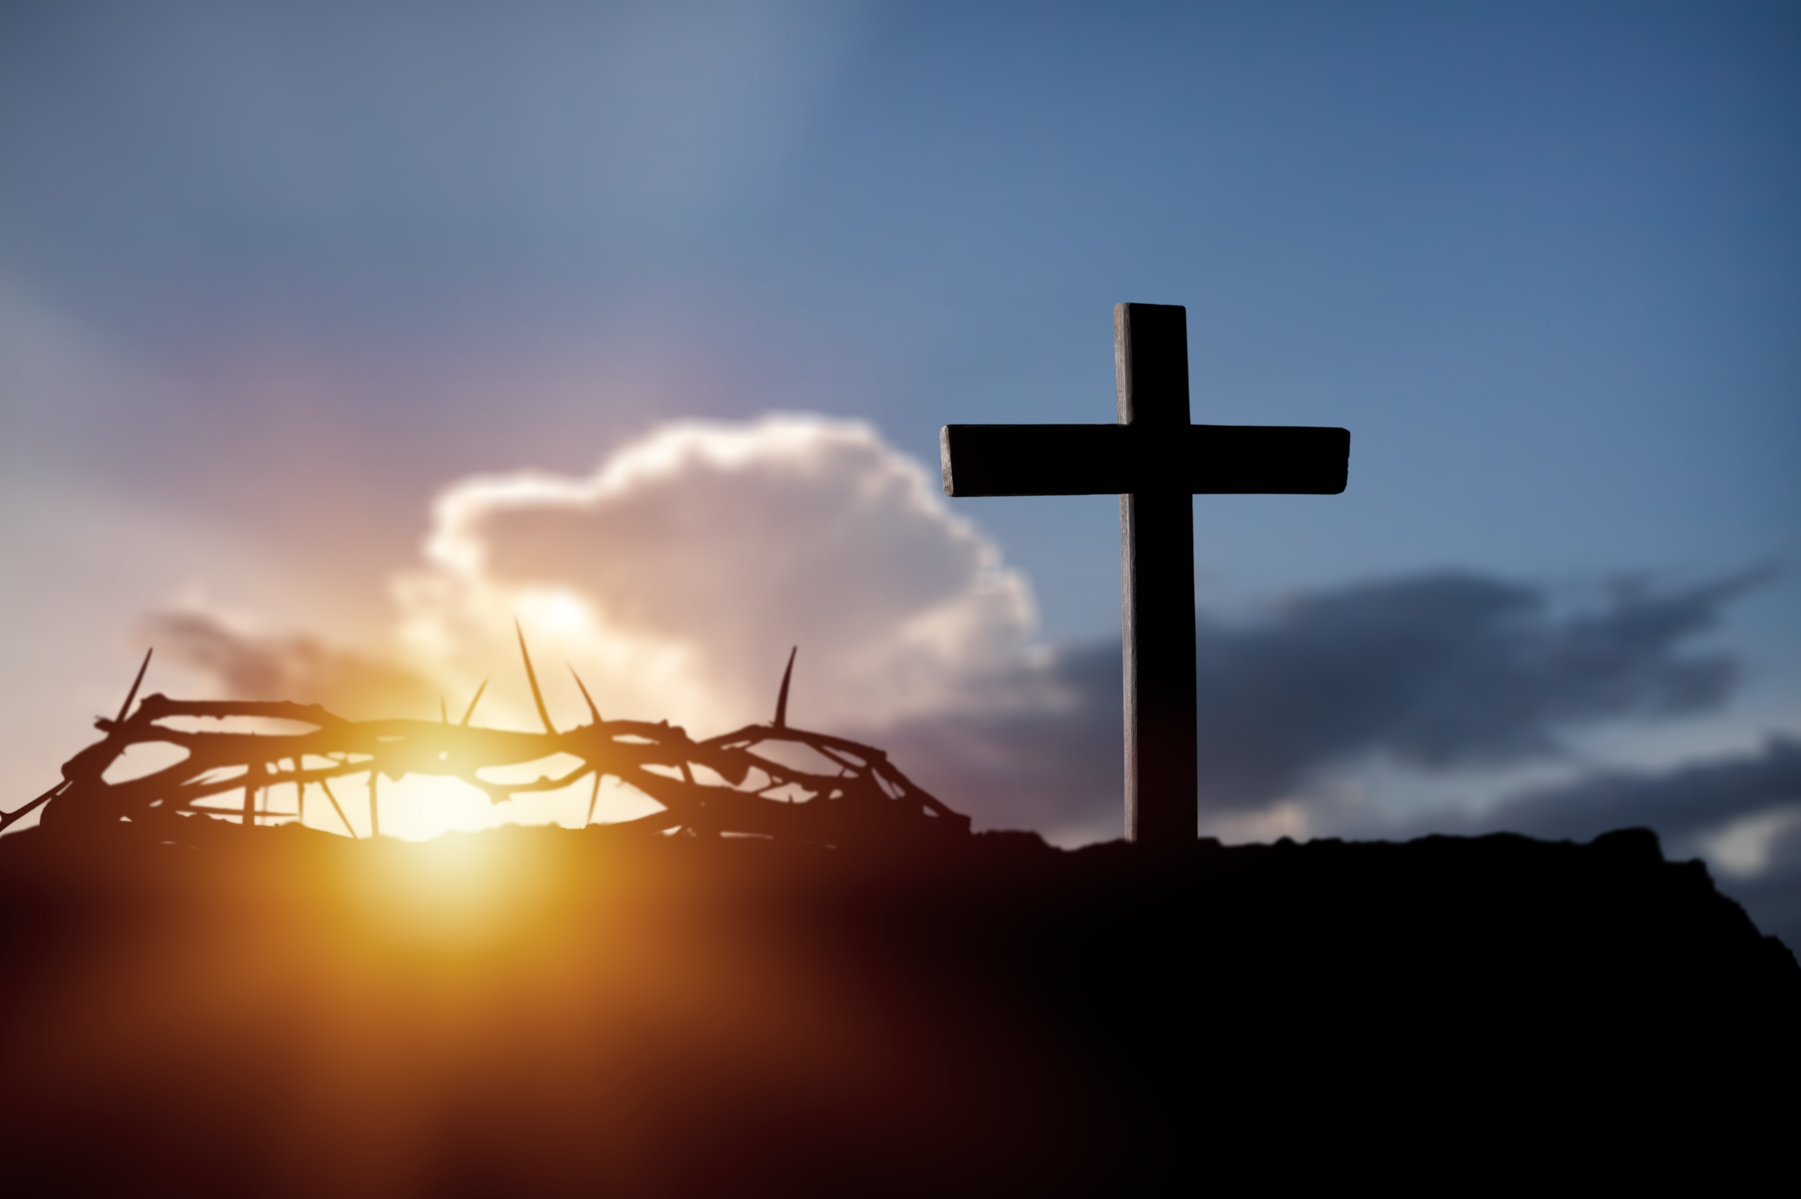
Focused on Jesus in 2026
Colossians 3:1-3

Slide 2
Colossians 3:1-3 (NASB)
¹ Therefore, if you have been raised with Christ, keep seeking the things that are above, where Christ is, seated at the right hand of God.

Slide 3
Colossians 3:1-3 (NASB)
² Set your minds on the things that are above, not on the things that are on earth. ³ For you have died, and your life is hidden with Christ in God.

Slide 4
This phrase is a direct quote from Colossians 3:2 in the King James Version (KJV) of the Bible. It serves as a central exhortation for believers to shift their internal focus and priorities from temporary, worldly concerns to eternal, spiritual realities.

Slide 5
Core Meaning and Context:
Defining "Affection": In the original Greek (phroneō), the word refers to more than just emotions; it means to direct the mind, to think, or to have a specific inner disposition. Modern translations often use the phrase "set your mind" to capture this active mental focus.

Slide 6
The Contrast:
The verse establishes a clear divide between "things above" (heavenly values like love, peace, and God's character) and "things on the earth" (materialism, status, or sinful behaviors).

Slide 7
The Foundation:
This command follows Colossians 3:1, which states that because believers are "risen with Christ," they should naturally seek the things where Christ is currently seated.

Slide 8
Practical Application in 2026
Living out this verse involves several intentional habits:

Slide 9
Guarding Mental Input:
Actively filtering social media, entertainment, and conversations that prioritize temporary greed or anxiety over eternal peace.

Slide 10
Renewing the Mind:
Engaging with Scripture and prayer to "recalibrate" your thoughts daily, similar to how a compass always returns to North.

Slide 11
Seeking Eternal Impact:
Prioritizing actions that have lasting value, such as serving others and fostering a "patient heart," rather than chasing immediate gratification.

Slide 12
Maintaining Balance: Scholars note that being "heavenly minded" does not mean ignoring earthly responsibilities; rather, it means performing those duties (like work and family care) for the glory of God rather than for personal gain.

Slide 13
5) Would you like to explore specific Bible study methods or daily devotionals to help maintain this focus, or work on the memory verse every day?

Slide 14
Philippians 2:5 (KJV)
Let this mind be in you, which was also in Christ Jesus:

Slide 15
Romans 15:3 (KJV)
For even Christ pleased not himself; but, as it is written, The reproaches of them that reproached thee fell on me.

Slide 16
Matthew 11:29 (KJV)
Take my yoke upon you, and learn of me; for I am meek and lowly in heart: and ye shall find rest unto your souls.

Slide 17
I Peter 2:21 (KJV)
For even hereunto were ye called: because Christ also suffered for us, leaving us an example, that ye should follow his steps:

Slide 18
I Peter 4:1 (KJV)
Forasmuch then as Christ hath suffered for us in the flesh, arm yourselves likewise with the same mind: for he that hath suffered in the flesh hath ceased from sin;

Slide 19
Ephesians 5:2 (KJV)
And walk in love, as Christ also hath loved us, and hath given himself for us an offering and a sacrifice to God for a sweetsmelling savour.

Slide 20
Galatians 2:19-20 (NASB)
¹⁹ "For through the Law I died to the Law, so that I might live for God.
²⁰ "I have been crucified with Christ; and it is no longer I who live, but Christ lives in me;

Slide 21
Galatians 2:19-20 (NASB)
and the life which I now live in the flesh I live by faith in the Son of God, who loved me and gave Himself up for me.

Slide 22

…that Christ died for our sins according to the scriptures;
And that he was buried, and that he rose again the third day according to the scriptures:

Slide 23
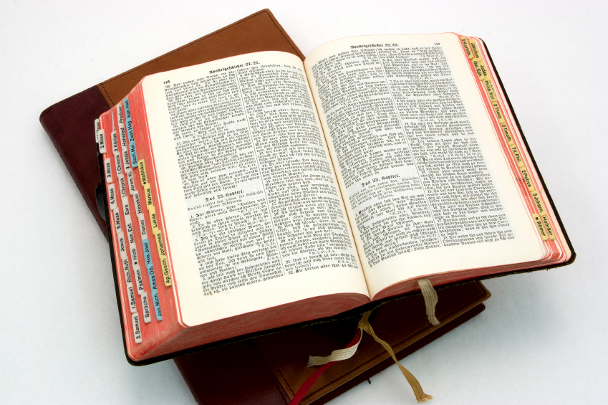
Hear: Romans 10:17
So then faith cometh by hearing, and hearing by the word of God.

Slide 24
Believe: Hebrews 11:6
But without faith it is impossible to please him: for he that cometh to God must believe that he is, and that he is a rewarder of them that diligently seek him.

Slide 25
Repent: Luke 13:3
I tell you, Nay: but, except ye repent, ye shall all likewise perish.

Slide 26
Confess: Matthew 10:32-33
32 Whosoever therefore shall confess me before men, him will I confess also before my Father which is in heaven.
33 But whosoever shall deny me before men, him will I also deny before my Father which is in heaven.

Slide 27
Baptize: Acts 22:16
And now why tarriest thou? arise, and be baptized, and wash away thy sins, calling on the name of the Lord.

